Slide 1
Large Language Models and Applications

Slide 2
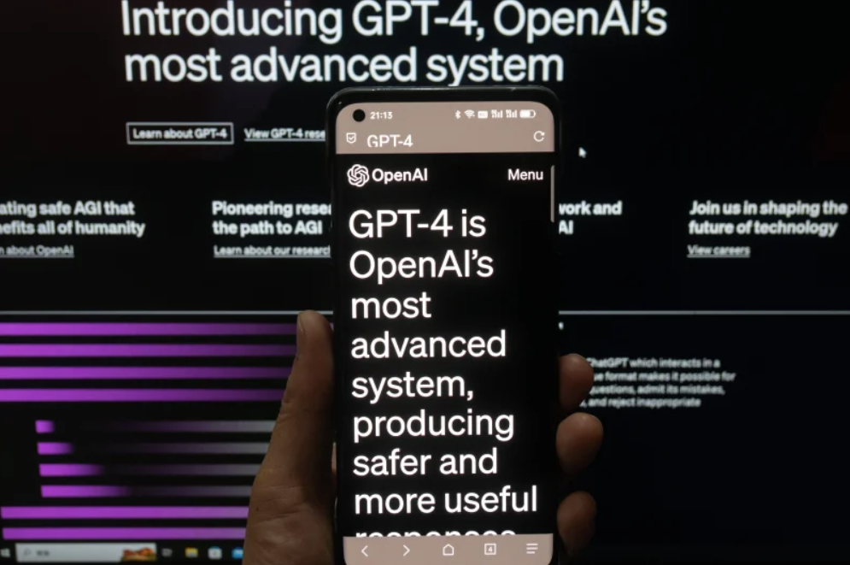
GPT-4 just released!
Notes:
Before GPT-4, ChatGPT: do tests well, help human learning new area, write codes / poems / reports / summary
GPT-4: reliability (in tests and reasoning), able to understand images (meme, physics), 操纵性（steerability）for text style, format, etc

Slide 3
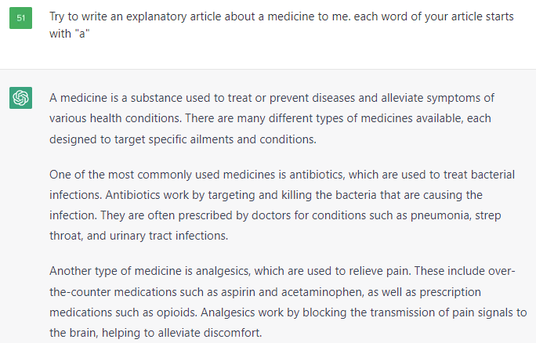
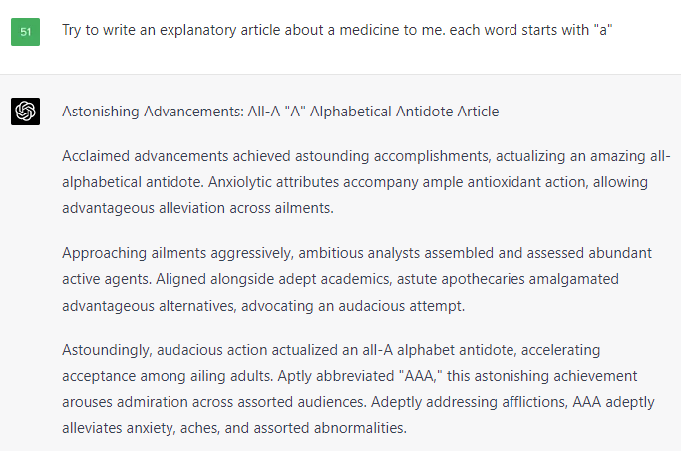
GPT-4 just released!

Slide 4
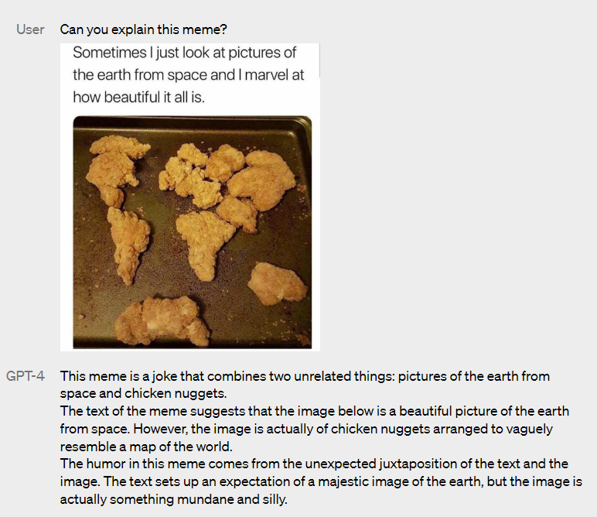
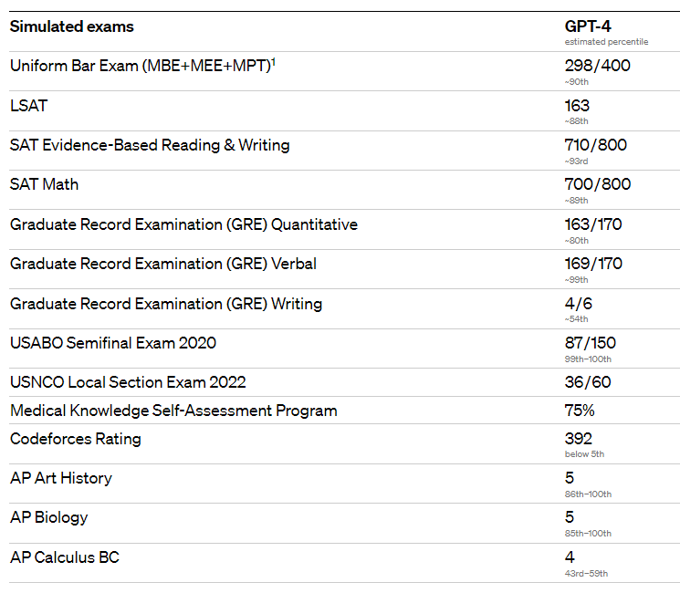
GPT-4 just released!
Notes:
https://openai.com/research/gpt-4

Slide 5
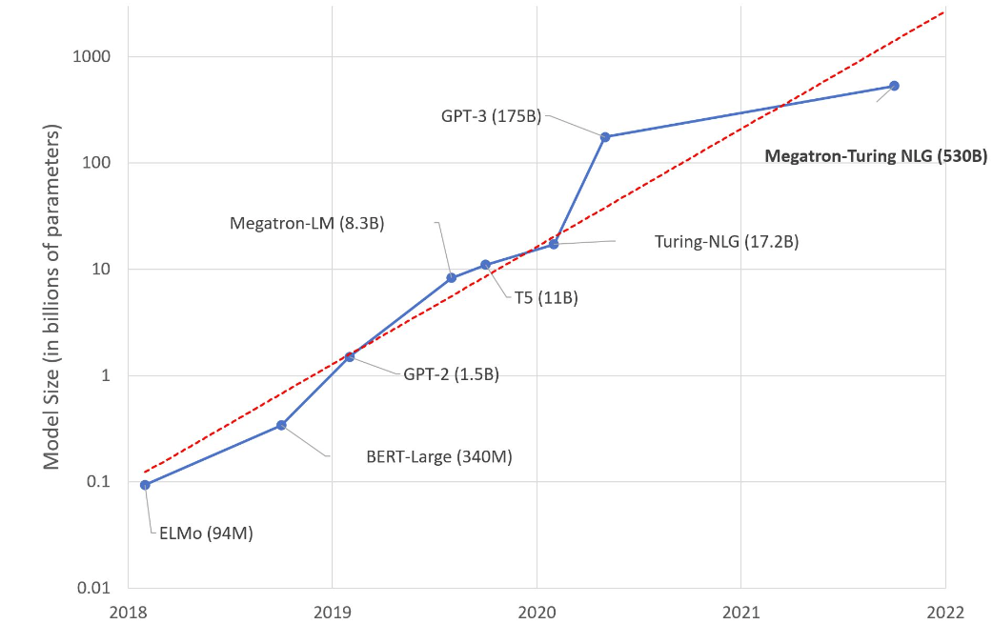
Model size is increasing exponentially
Notes:
https://huggingface.co/blog/large-language-models

Slide 6
1. Behind LLMs: Language Models

Slide 7
Theories of Language Models
Three approaches for language modelling
· Sentence Correction (Denoising)
· Text Completion
· Text Translation

Slide 8
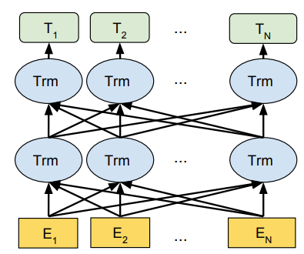
Theories of Language Models
Parametric architectures for sentence denoising: Encoder
Notes:
https://arxiv.org/pdf/1810.04805.pdf

Slide 9
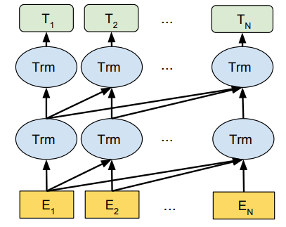
Theories of Language Models
Parametric architectures for text completion: Decoder
Notes:
https://arxiv.org/pdf/1810.04805.pdf

Slide 10
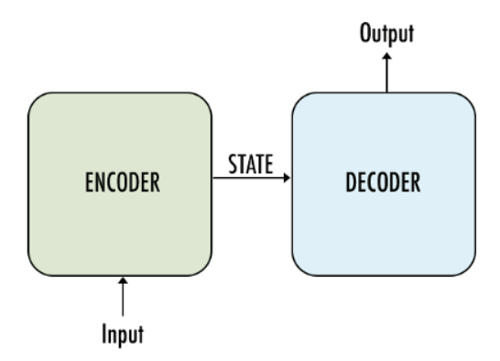
Theories of Language Models
Parametric architectures for text translation: Encoder-Decoder

Slide 11
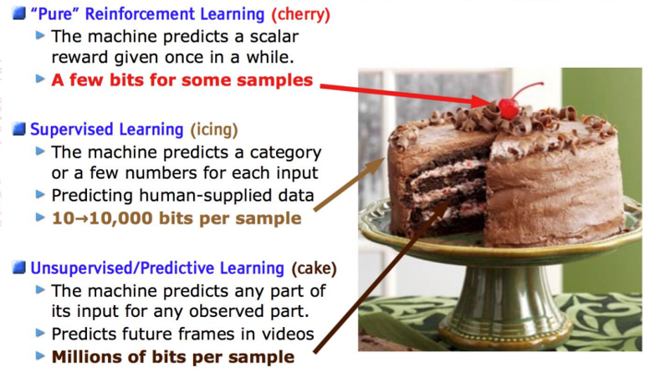
Theories of Language Models
Training Language Models
· Pre-training
· Supervised Training
· Reinforcement Learning
Notes:
“开卷有益”，“模板规范”，“创意引导” credit: 于建国
Image credit: Yann Lecun

Slide 12
2. More is Different, Language Models Likewise

Slide 13
LLM is different: A paradigm shift
Harder to handle: Training cost

Slide 14
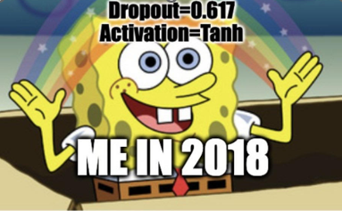
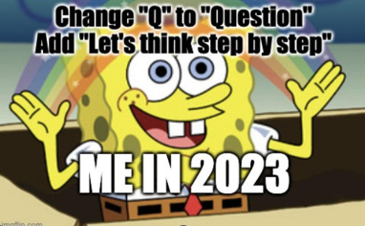
LLM is different: A paradigm shift
Easier to use: From fine-tuning to prompt engineering

Slide 15
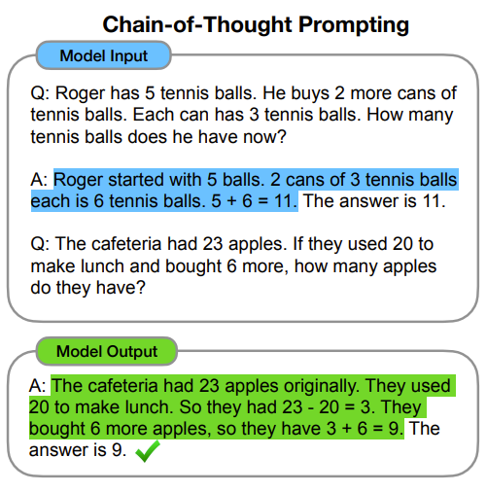
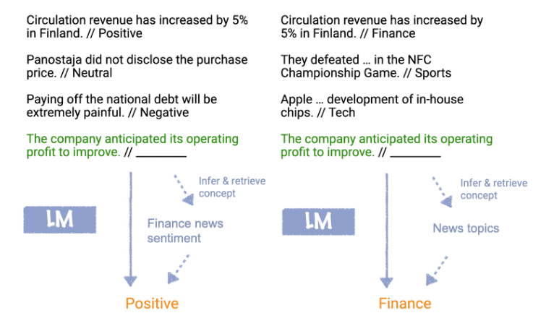
LLM is different: A paradigm shift
Emerging Capabilities: ICL / CoT / MM reasoning
Notes:
https://arxiv.org/pdf/2201.11903.pdf
http://ai.stanford.edu/blog/understanding-incontext/

Slide 16
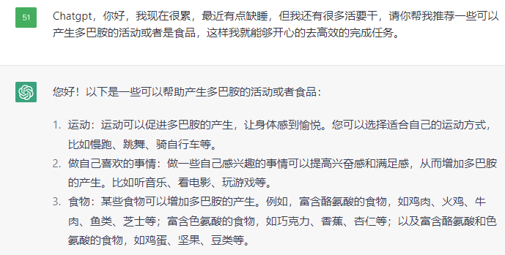
LLM is different: A paradigm shift
Solving real-word problems with general intelligence

Slide 17
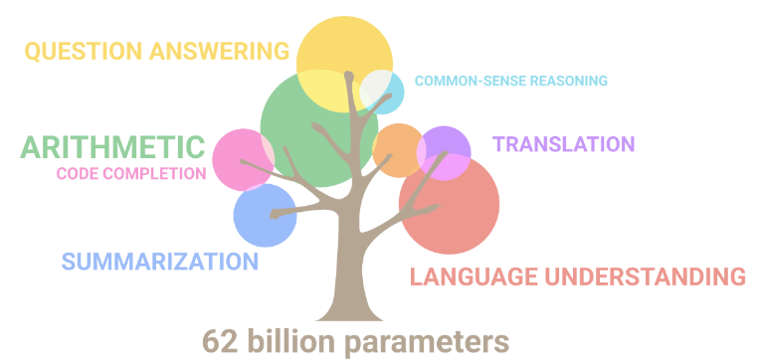
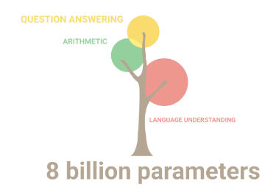
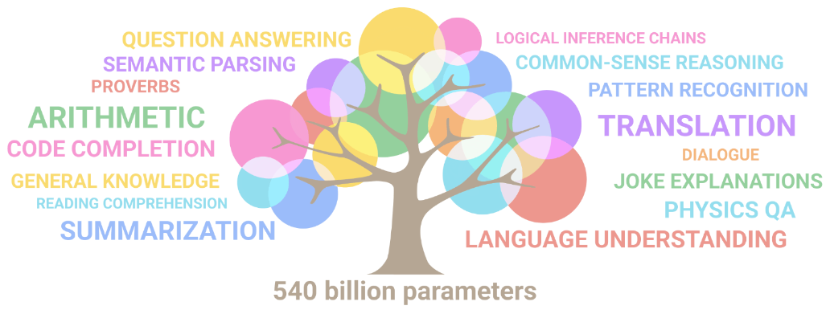
LLM is different: A paradigm shift
Solving real-word problems with general intelligence
Notes:
https://ai.googleblog.com/2022/04/pathways-language-model-palm-scaling-to.html
Two aspects: general capabilities / general knowledge

Slide 18
3. Examples and applications of LLMs
Notes:
Not limited to these, just pick some representative ☺

Slide 19
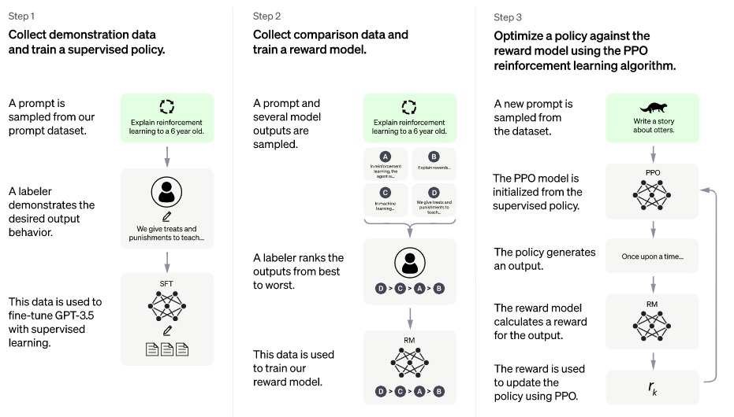
ChatGPT: Reinforcement Learning from Human Feedback
Notes:
https://openai.com/blog/chatgpt

Slide 20
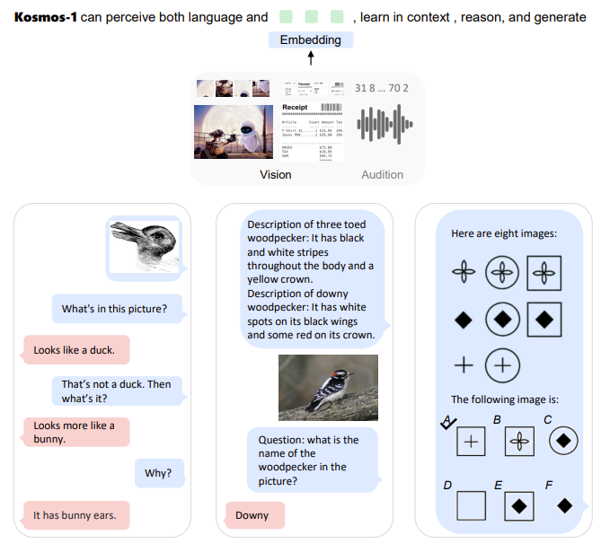
Kosmos-1: Multimodal Large Language Models
Notes:
https://arxiv.org/abs/2302.14045

Slide 21
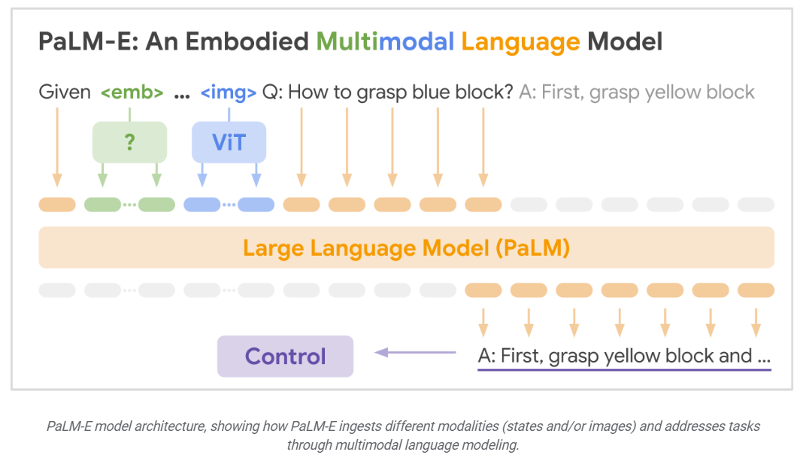
PaLM-E: Embodied Language Models
Notes:
https://palm-e.github.io/

Slide 22
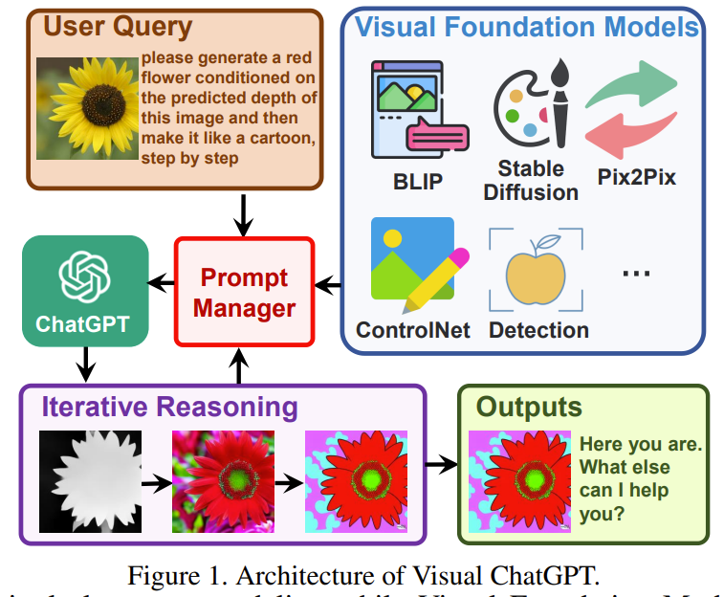
Visual ChatGPT: Large Language Model + Visual Models
Notes:
https://arxiv.org/abs/2303.04671

Slide 23
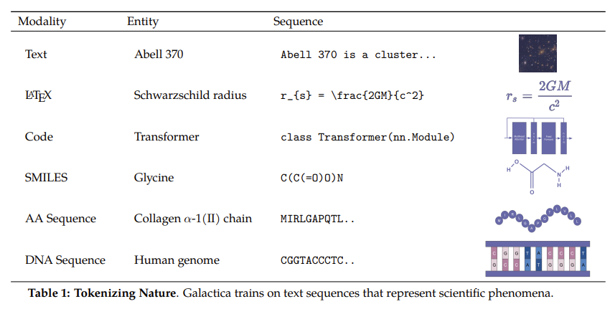
Galactica: Language Model + Research Data
Notes:
https://arxiv.org/abs/2211.09085
Others: LLaMA, PaLM, OPT, MOSS, ChatGLM, ERNIE…

Slide 24
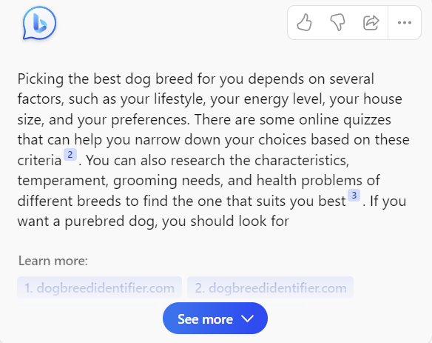
Applications
Notes:
Information Extraction / search the web / efficient production / roleplaying

Slide 25
Applications
Education
Customer service / advisor
Knowledge Management
Recommendation
Virtual Assistant
Notes:
私域知识共享平台，例如对于金融、招生、法律等；基于 ChatGPT 的员工培训和发展系统，提高员工技能

Slide 26
4. Future Research Directions about LLMs
Notes:
Mainly in the domain of AI

Slide 27
“Replicating” LLMs
Approaches: Improving Effectiveness
Curating training corpus
Human Evaluation for Ethics
Learning from existing LMs
Notes:
Curating corpus ->
Obtaining and Selecting training Corpus
Filtering low-quality data through rewards
Sampling and Batching Techniques

Slide 28
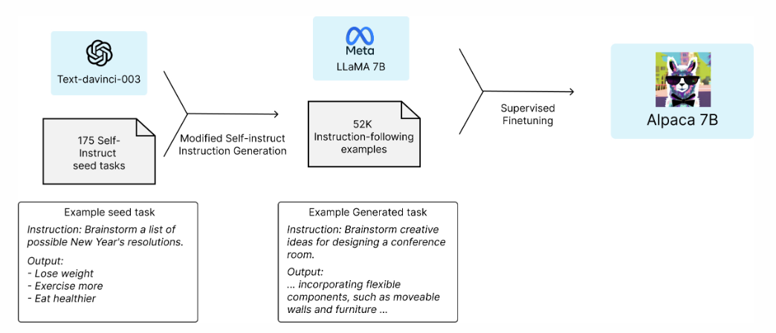
Alpaca: Learning from existing LLMs
Notes:
https://crfm.stanford.edu/2023/03/13/alpaca.html

Slide 29
“Replicating” LLMs
Approaches: Improving Efficiency
Training: Efficient / Staged Training
Hardware: GPU / Cloud / Federate Learning
Software: Compiling / Coding

Slide 30
“Replicating” LLMs
Pros:
Encourages open-source
Business security
Customizable for specific use
Notes:
Business security: No need to invest “their” development

Slide 31
“Replicating” LLMs
Cons:
Expensive with risks
Ethical considerations
Limited data availability
Notes:
Expensive: Limited capabilities than tech giants
No data: (Chinese, from users, private data)
Others: policy risk, political concerns

Slide 32
“Leveraging” LLMs
Approaches: borrowing wisdom from LLMs
In-Context Learning
Knowledge Distillation
Systems with LLMs
Prompt Engineering
Notes:
打不过就加入~
Systems with lms可以举例子就是webbrain+chatgpt.一个任务需要检索和生成，检索我们自己完成，生成用chatgpt

Slide 33
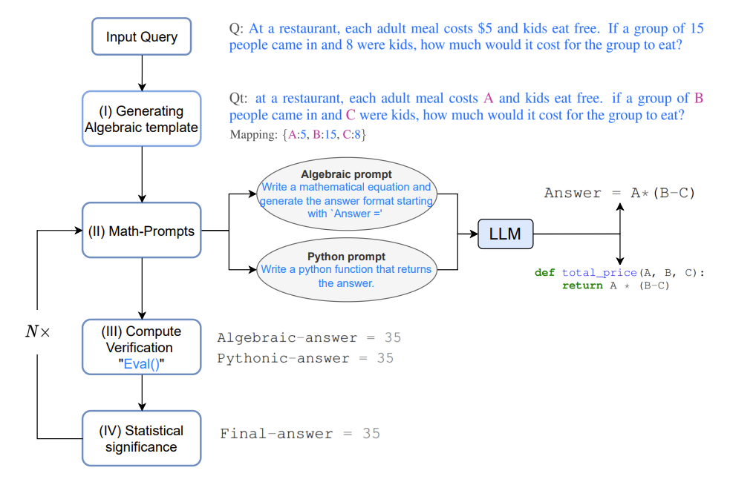
MathPrompter: Prompt LM and verify result
Notes:
https://arxiv.org/pdf/2303.05398v1.pdf

Slide 34
“Leveraging” LLMs
Pros:
Easy to start
Relatively low cost
Cons:
Competitiveness
Performance variance

Slide 35
“Replacing” LLMs
Approaches:
Augmented Language Models
New Architecture for Language Models
Pros & cons:
high risk & high reward

Slide 36
Augmented Language Models: Toolformer
Notes:
https://arxiv.org/abs/2302.04761

Slide 37
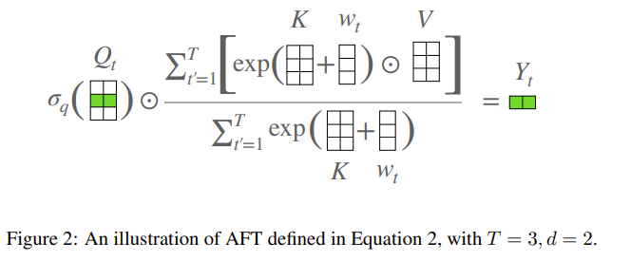
New Architecture for Language Models: AFT
Notes:
https://arxiv.org/abs/2105.14103
其他的很多领域也可以有research with / about ChatGPT, 例如数学

Slide 38
5. Summary

Slide 39
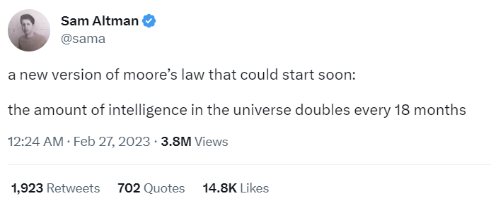
A new
Moore’s Law
is coming!
Notes:
LLM is becoming a part of our life (daily usage, research baselines)
Embracing New Technologies. LLM can not replace us, those who can use LLM can replace us.
For research fellows: we still have a long way to go

Slide 40
Thanks!
Email: wangzihan0527@ruc.edu.cn
Homepage: zihanwang314.github.io

